Slide 1
The eternal argument about new treatments makes perfect sense once you realize…

Slide 2

The eternal argument about new treatments makes perfect sense once you realize…
We’re in the middle of an opera!

Slide 3
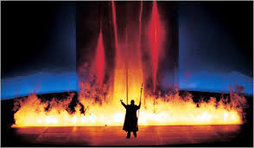
PART V. Reprise of the rhinegold
An Opera in 3 Acts

Slide 4
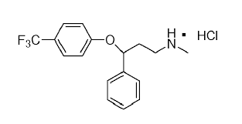
Act 1, Scene 1 – The New Ring
The Rhinemaidens discover a new cache of Rhinegold and forge a psychoactive double ring.
Whatnexitine is born into the real world!

Slide 5

“Whatnexitine is indicated for
treatment of major depression in adults.”

Slide 6
Act 1, Scene 2 – Clash of the Titans
The arrival of Whatnexitine re-ignites the age-old enmity between half-brothers Pharma and Healthplan.
The epic battle is renewed!

Slide 7
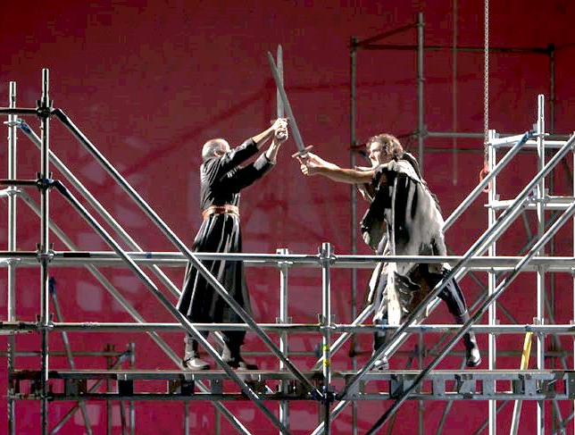
Pharma: “This new mechanism of action offers hope to all those not helped by existing treatments. Whatnexitine must be available to everyone!”
Healthplan: “Whatnexitine costs 20 times as much as effective alternatives. We might partially cover it, but only when all other options fail!”

Slide 8
Act 1, Scene 3 – The Earthly Lament
As the endless battle continues above their heads, Patient and Doctor beseech the titans with a mournful duet.

Slide 9

Patient: “Can I trust either of you to say what’s best for me?”
Doctor: “Will either of you give me any information I can actually use?”

Slide 10
Act 2, Scene 1 – The Indifferent Gods
Looking down from the ruins of Valhalla, the Regulatory Gods seem powerless to end the eternal struggle.

Slide 11

FDA: “We’d love to help, but our job is done.”
CMS: “We’d love to help, but our hands are tied.”

Slide 12
Act 2, Scene 2 – The Foolish Chorus
The researchers dance in to provide much-needed comic relief.

Slide 13

“Give me all the gold, and I’ll settle this argument by the time that nobody cares anymore.”

Slide 14
Act 3 – The Truth Revealed
Can we learn if Whatnexitine is good or evil?
Will the eternal struggle be resolved?

Slide 15
Evidence generation for the real world
Broader questions
  Effectiveness, tolerability, heterogeneity and value
More flexible designs
Faster and cheaper

Slide 16
A different kind of surveillance
Safety surveillance
  Rare outcomes with clear claims “signal”
  Confounding less a concern with “off-target” effects
Effectiveness surveillance
  Common patient-centered outcomes
  Confounding by indication more a concern

Slide 17
Use case: Evaluation of new depression treatments
What we have:
  Accurate information on drug exposures
  Increasingly consistent outcome assessment
  Longitudinal data across treatment episodes
What we lack:
  Accurate/specific information on non-drug treatmennts
  Usable information regarding adverse effects
  Usable information regarding treatment choices

